Slide 1
Newton’s Second Law
By 1102

Slide 2
F = ma
Force = Mass x Acceleration

Slide 3
Relationship
m=F/a
More mass ===== less acceleration
Less mass ===== more acceleration
F=ma
More force ==== more acceleration
Less force ==== less acceleration

Slide 4
Project:

Slide 5
Our Plan and processes

Slide 6
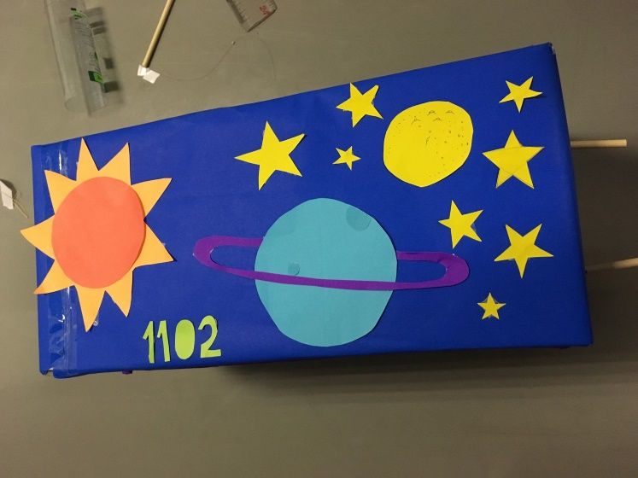
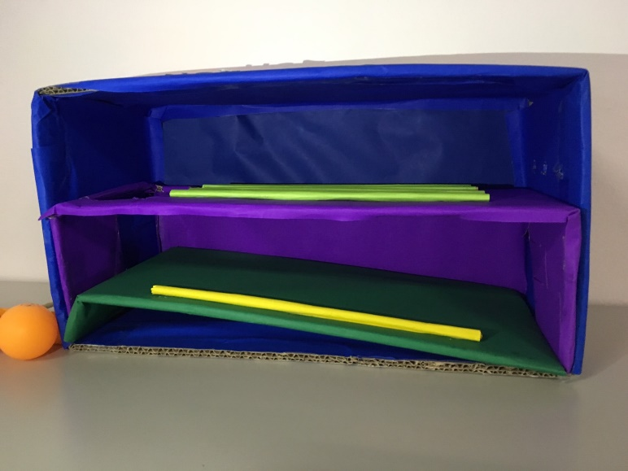
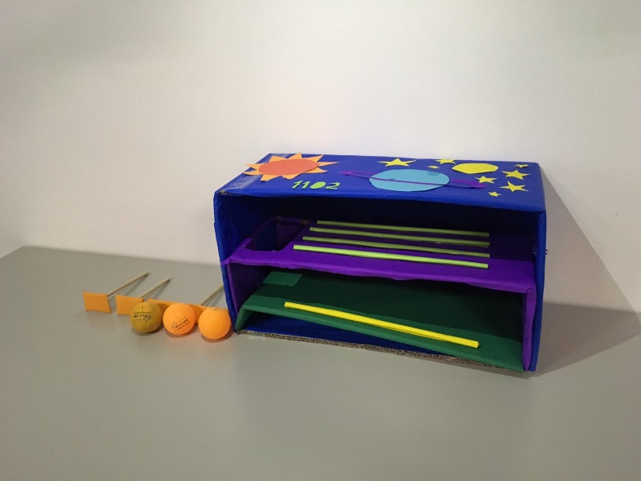
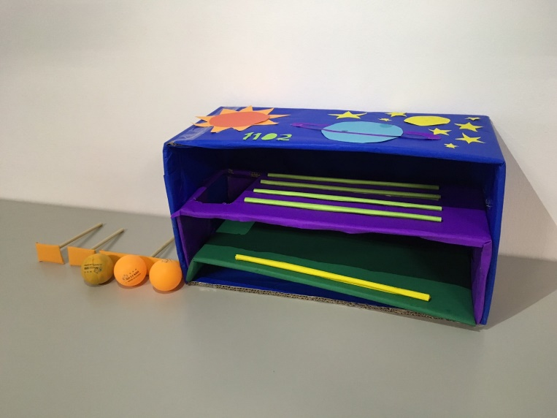
Our Project

Slide 7
Same force, Different mass
The one with more mass will have less acceleration.
The one with less mass will have more acceleration.

Slide 8
Same mass, Different force
The one with more force will have more acceleration.
The one with less force will have less acceleration.

